Slide 1
College Market App
By: Ndeye Mareme Lo
Hunter McIntosh
Divine Eziolise
Ari Kinney

Slide 2
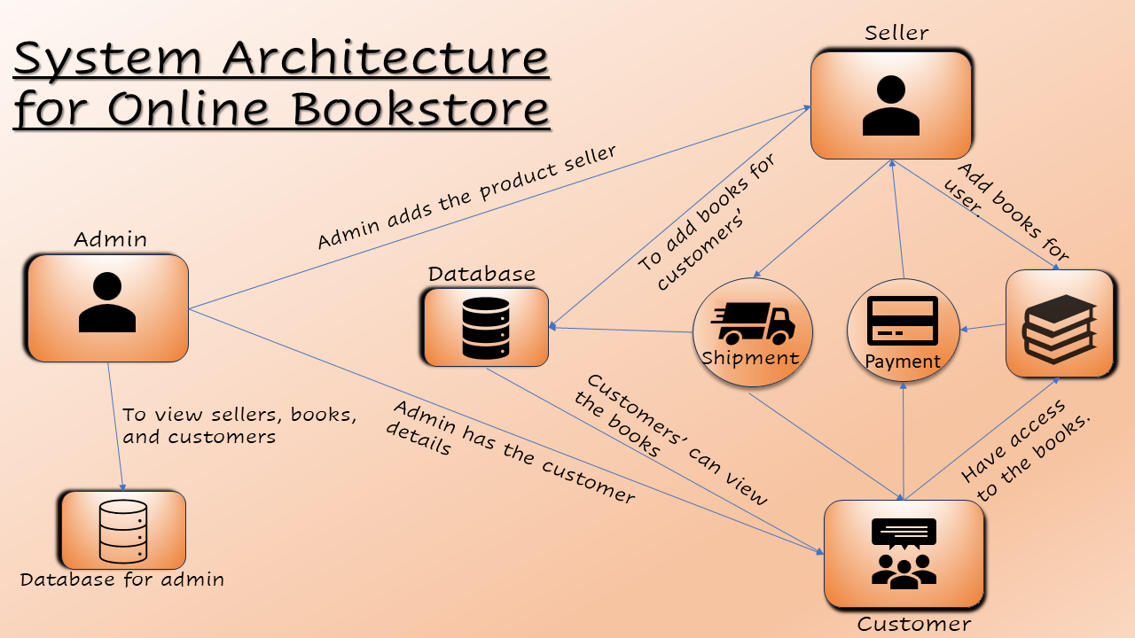
Project Overview
Deliverables
Audience
Purpose
Scope
Background
App Design
Approach
Budget & Equipment
Work Flow
Why This Matters
Summary
Conclusion
Future Improvement

Slide 3

Deliverables
Proof of concept of mobile/web application for student transactions.
Ability to help both, organizations & students get everything they want with a click of a button
User-friendly layout for easy navigation.

Slide 4

Audience
For College students looking to buy, sell, or trade items
University stuff, or faculty who may also participate
Local businesses for partnerships or sponsorships
Source: Chegg

Slide 5
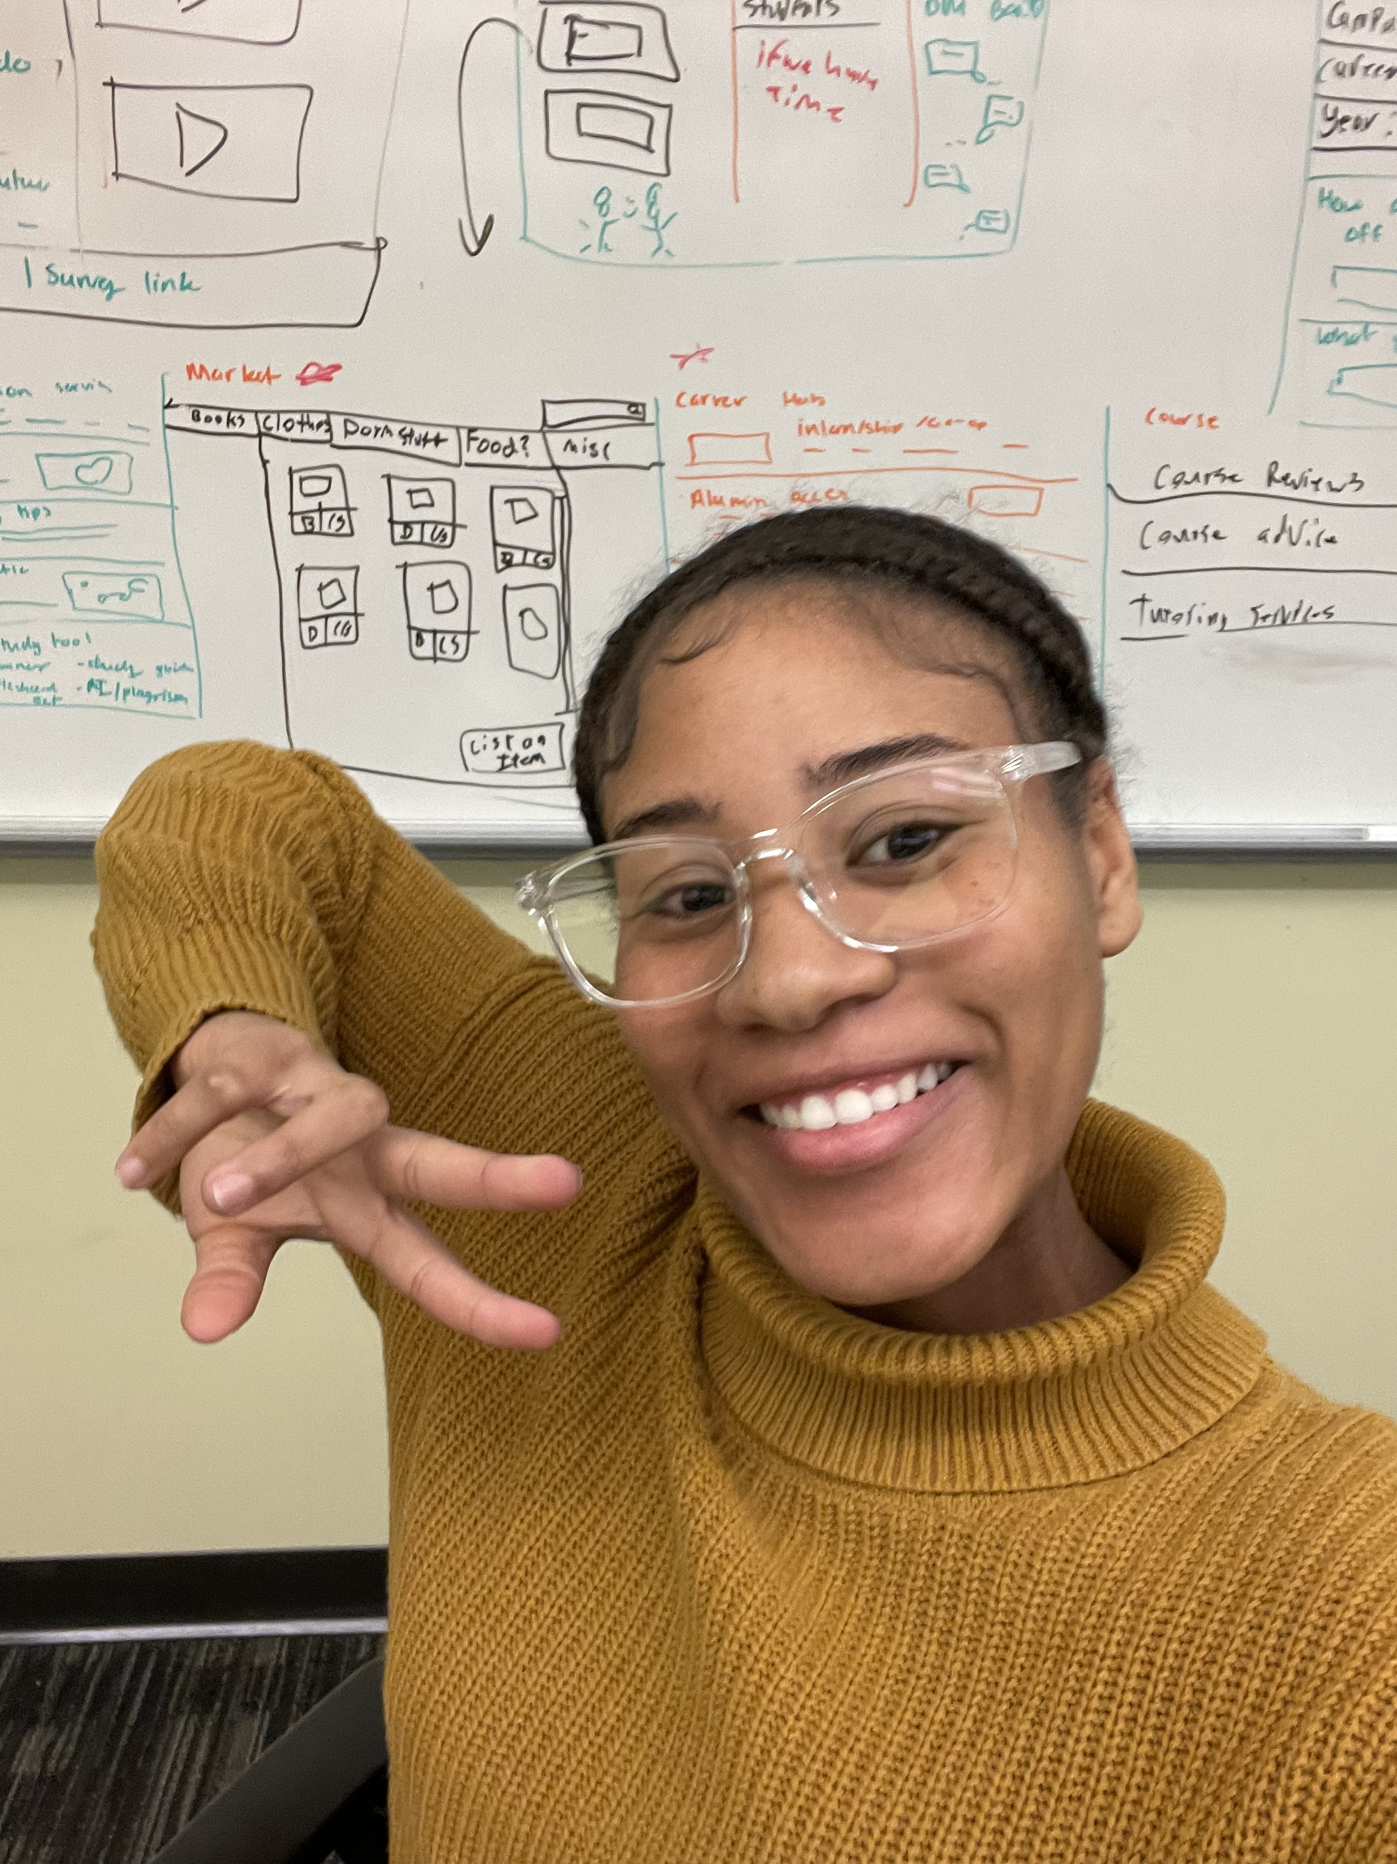
Purpose
Communication and Networking
By connecting students of same majors and interest into
groups
Provide a Student-Centered Marketplace
By assisting students to buy, sell, & trade their items
Easily & more conveniently within their college
community.
Promote Sustainability and Convenience
By reducing waste, reuse of pre-owned items
Enhance Affordability
By helping students save money on essential items like
textbooks, furniture, and electronics

Slide 6

Scope
Focused on a university community
Potential for expansion to multiple campuses
Limitations include no direct payment processing (transactions handled outside the App)

Slide 7
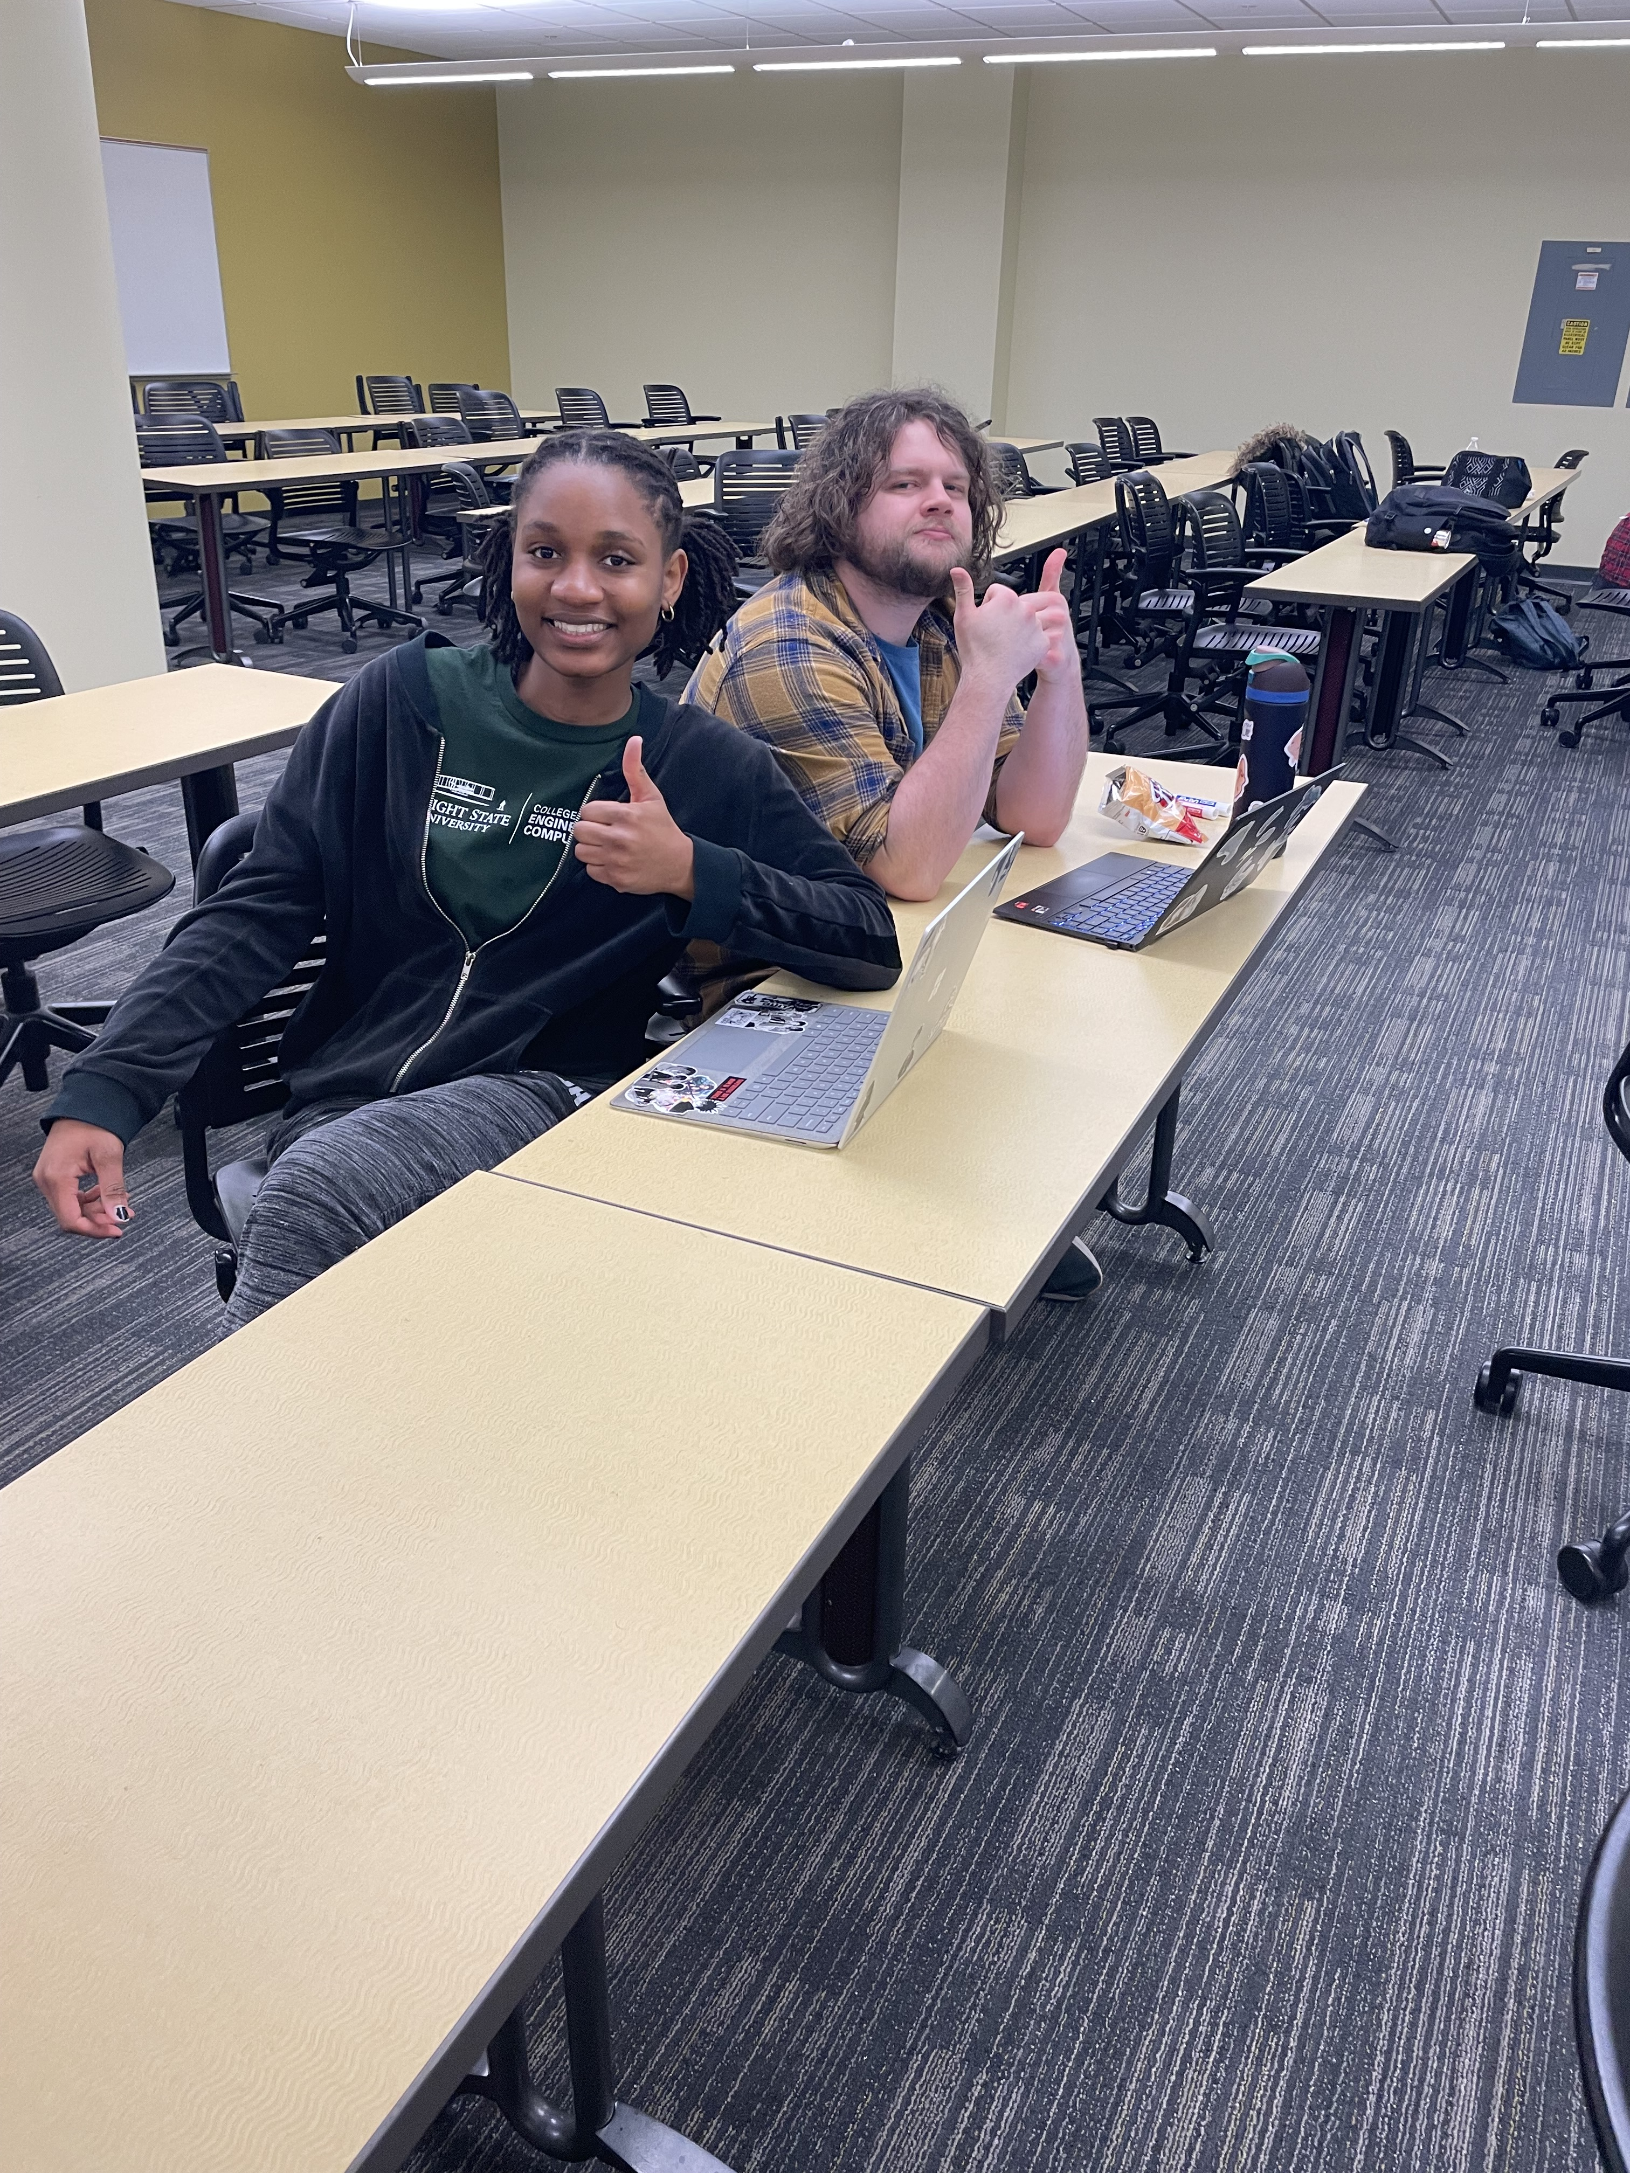
Background
College students often face high costs for textbooks, furniture, electronics, and other essentials
And many students struggle to buy or sell items efficiently on campus
Many existing solutions are not student-specific or secure
Notes:
The difference between carrhub on are site and and wright state

Slide 8
App Design
Clean, intuitive, and mobile-friendly design.
Simple navigation for listing, searching, and buying items.
Categorized listings for textbooks, electronics, furniture, etc.

Slide 9
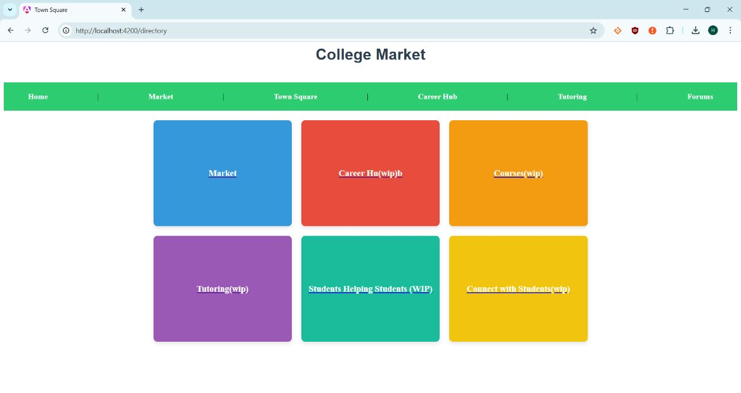
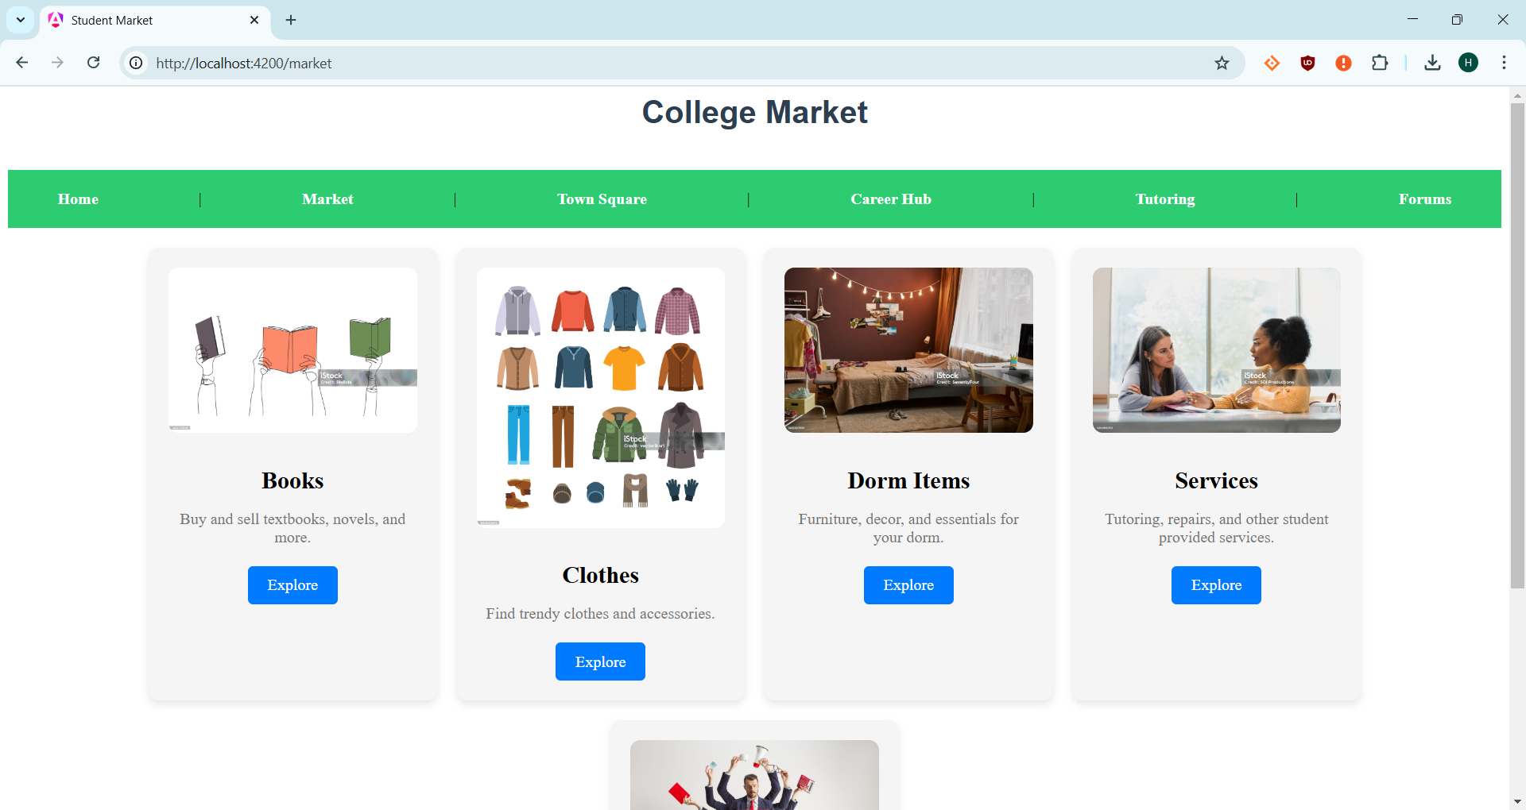
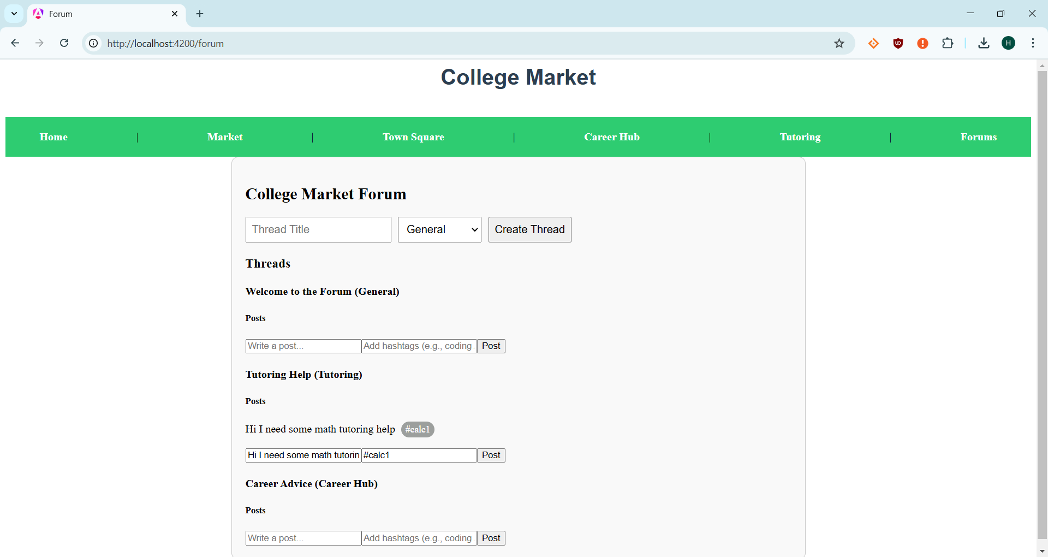
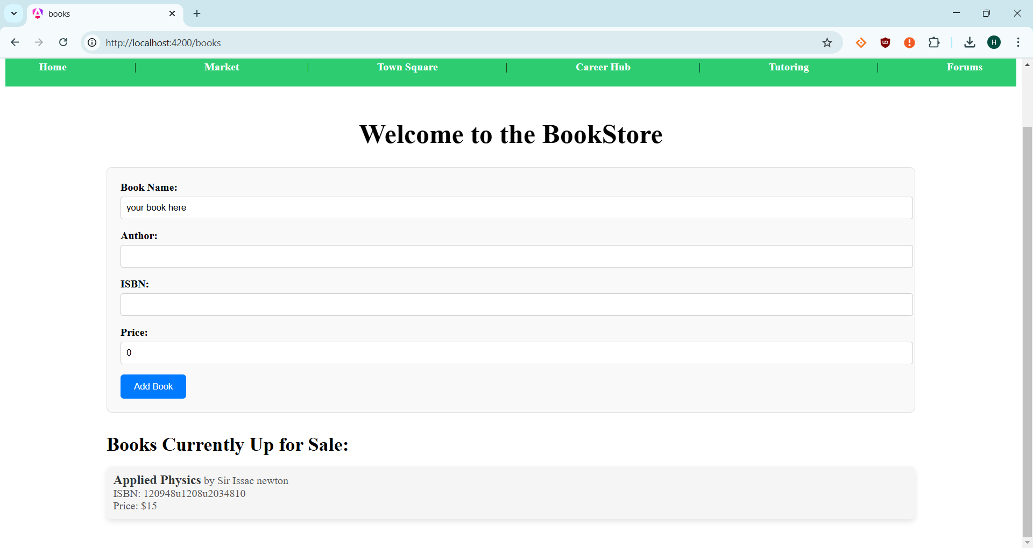
Home Screen
Market Selection page
Help Forums
Markets

Slide 10
Key Security Measures
User Authentication & Verification
University email verification ensures only students access the platform.
Two-Factor Authentication (2FA) enhances login security.
Data Protection & Privacy
TLS/SSL encryption secures data transmission.
End-to-end encryption protects private messages & transactions.
Compliance & Security Maintenance
Adherence to university data protection policies.
Regular security audits & software updates to prevent vulnerabilities.

Slide 11
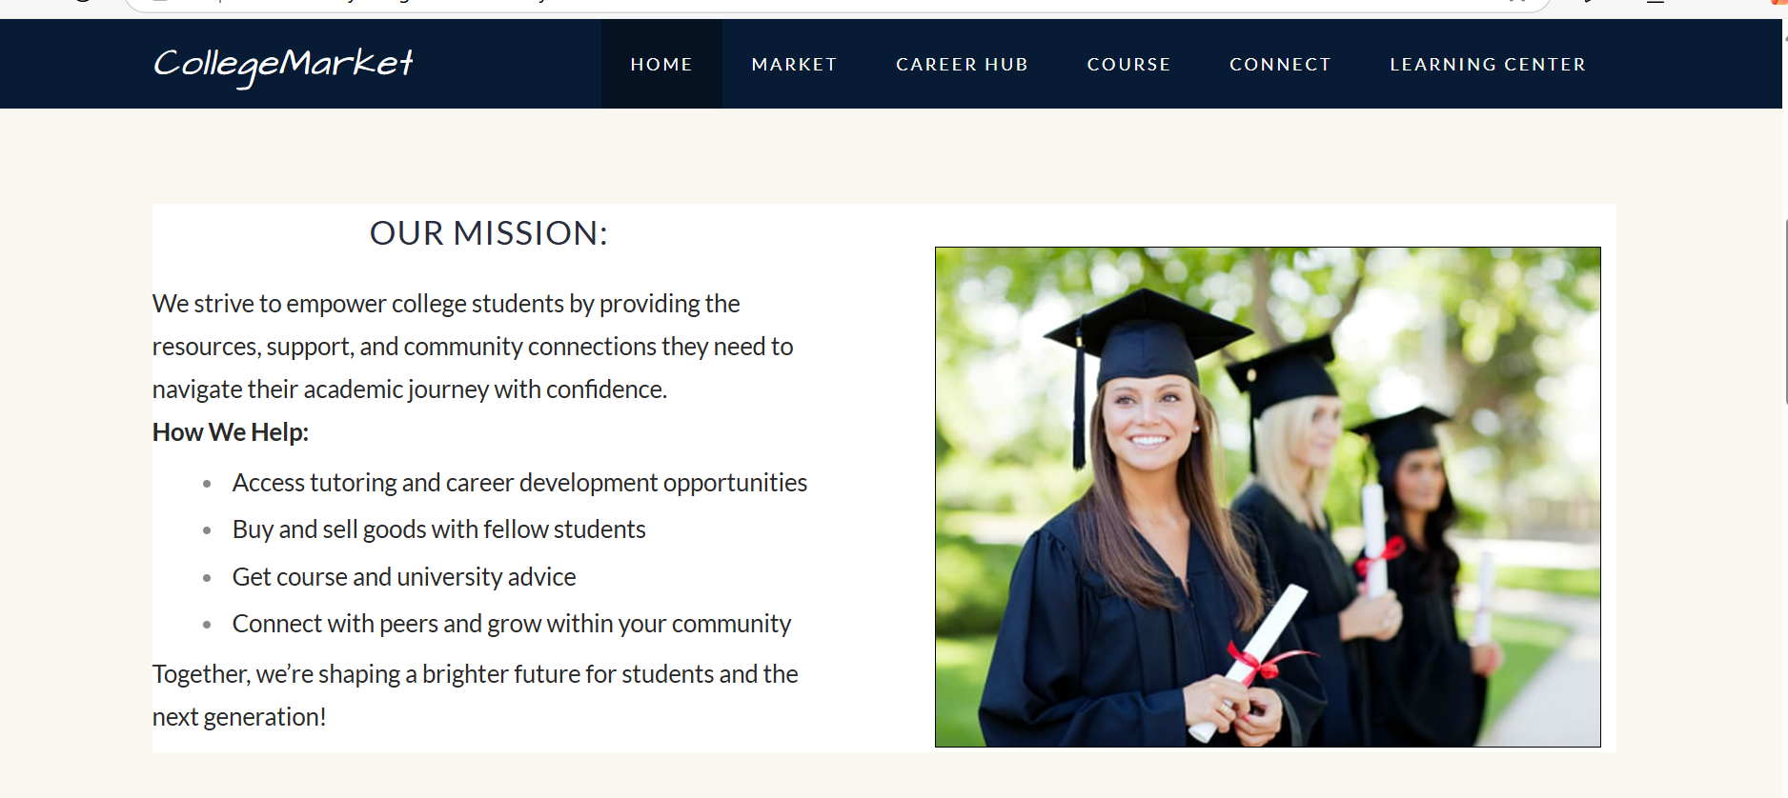
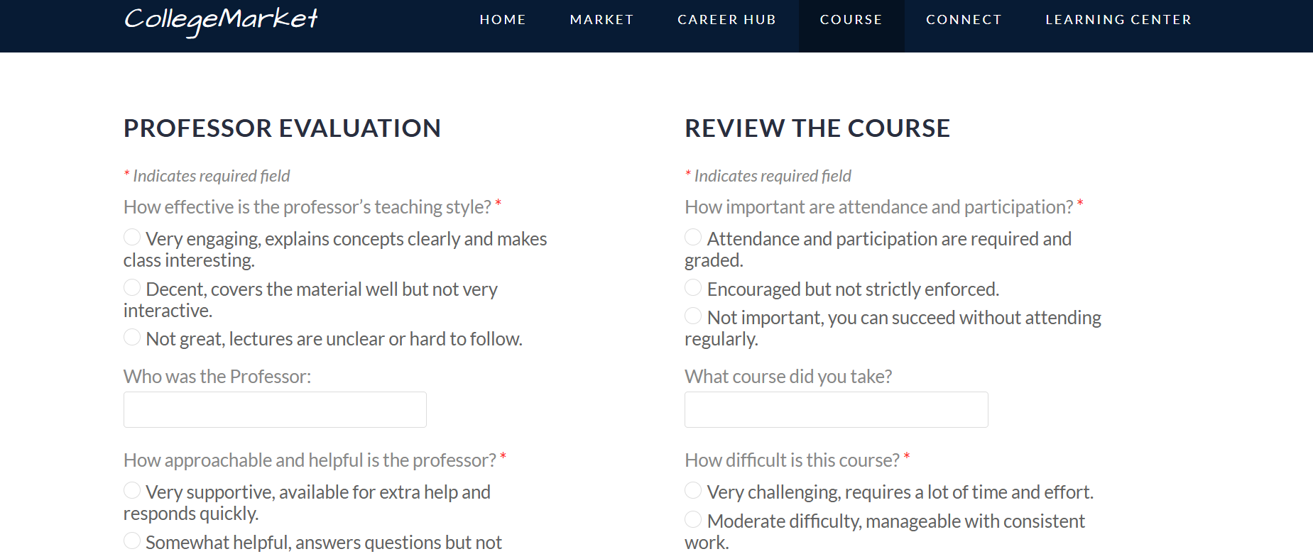
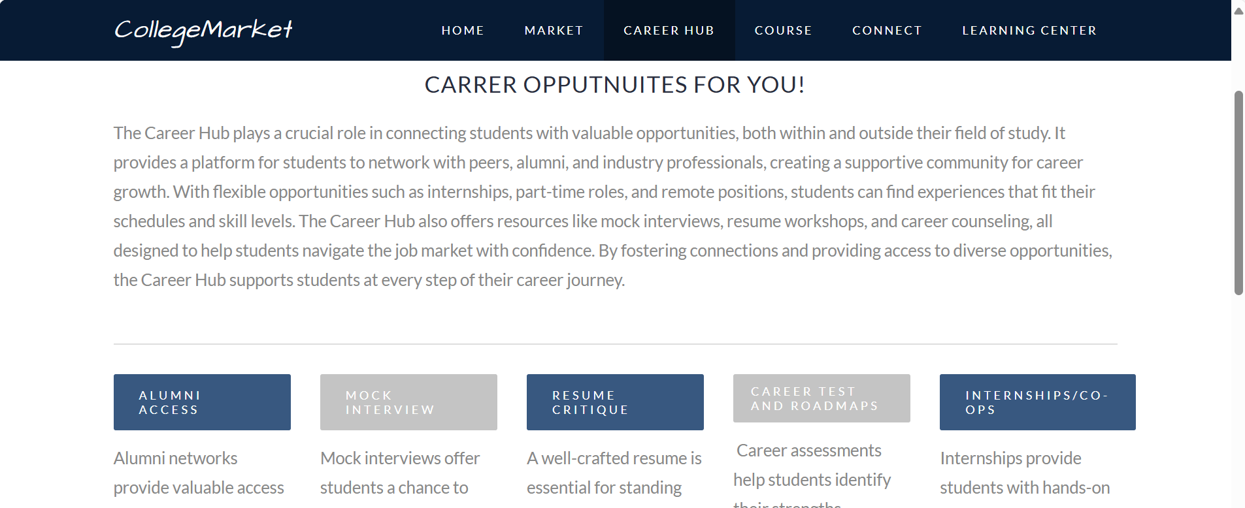

Slide 12
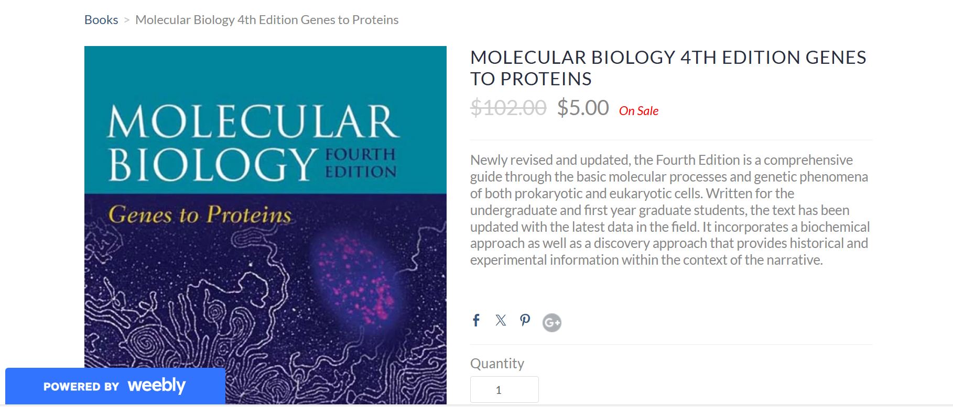
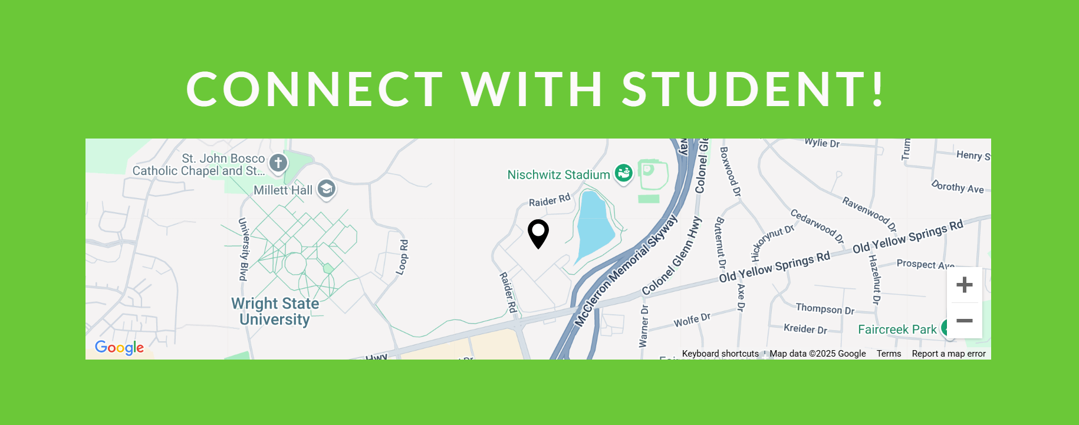
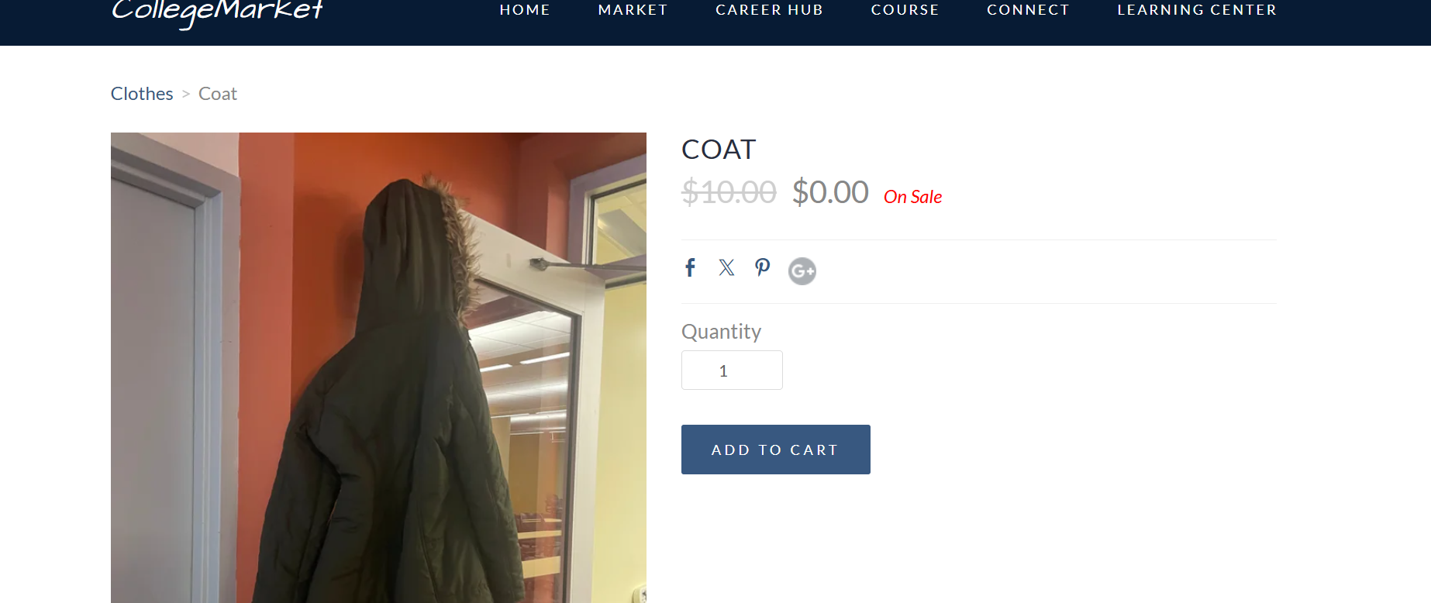

Slide 13
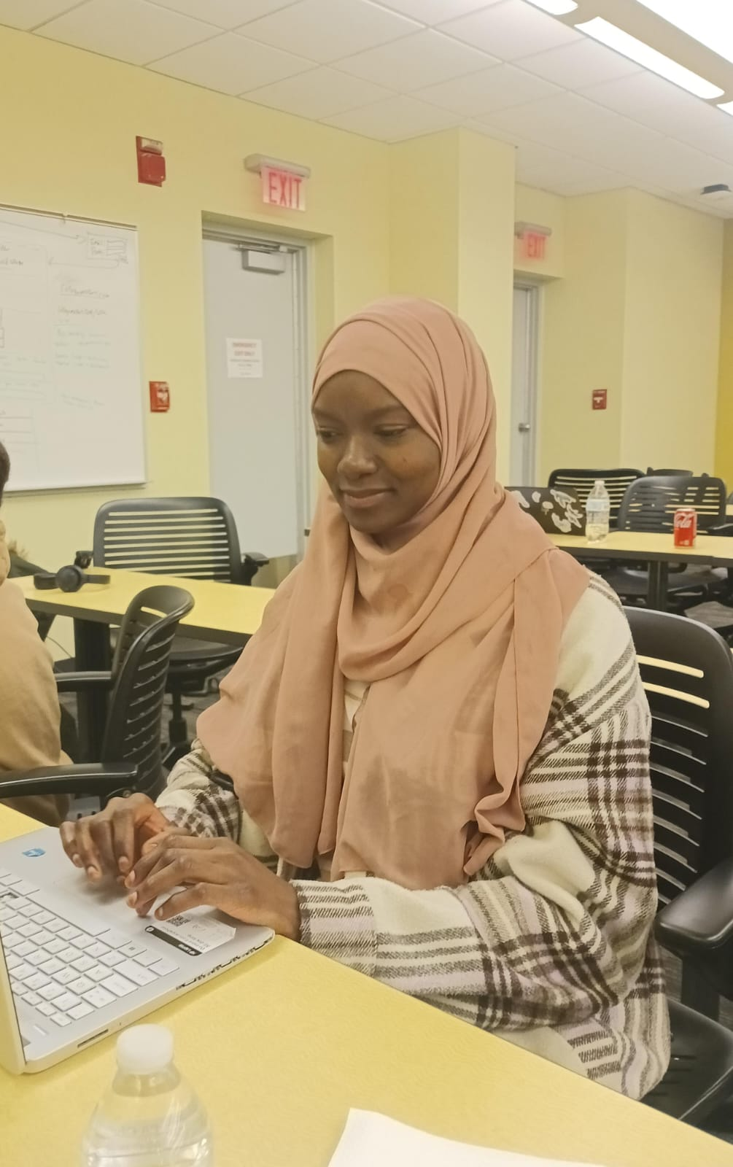
Approach/ Student Survey
Conducted a survey to understand student's needs & preferences
Some students stated that textbooks are quite expensive
Other struggle to study effectively for Exams

Slide 14
Budget & Equipment
Server Space
Development tools (Free)
Cost of employment
Software tools (Angular, ChatGPT, VS Code, Docker, and GitHub)

Slide 15
Work Flow
User Registration
Item Listing & Management
Browsing & Searching
Students sign up using their university email or ID verification
Users create listings by uploading item images, descriptions, and pricing
Users can edit or delete their listings as needed
Students can explore listings using filters such as category, price range, location, etc
The search functionality allows users to find specific items quickly.
Notes:
How we work as a team who contribute to what

Slide 16
Why this matters
Provides an effective cost solution for students to buy and sell essential items. Reduces financial burden by offering an affordable marketplace for student needs
Unlike public platforms such as Facebook Market this app ensures secure transaction within a verified college community.
Facilitates connections between students, university organizations, and local businesses for partnerships
Empowering Students
Creating a Safer Market Place
Enhancing Campus Connectivity
Notes:
Talk about personal experience have your voice heard connect to this app like others will in the futers

Slide 17

Summary
College Market App simplifies student transactions
Offers secure, easy to use, and organized platform

Slide 18
Conclusion
This College Market App benefits students by saving money and reducing waste
It is a future potential to expand features based on user needs
It focuses on affordability, sustainability, and ease of use
It addresses key student needs for low-cost essentials and a reliable way to interact with their campus community

Slide 19
Future Improvement
Roommate Finder
Subleasing Off Campus
College Review/Compatibility
Disability Usage
Volunteering Opportunities
https://communitycollegemarket.weebly.com/
Notes:
Long term goal some change we will make

Slide 20



We did it!

Slide 21

Any Questions
Contact Information
Ndeye Mareme Lo _
Lo.12@wright.edu
Hunter McIntosh – McIntosh.87@wright.edu
Divine Eziolise _ Eziolise.5@wright.edu
Ari Kinney _
Kinney.58@wright.edu

